Slide 1
an introduction to:
Deep Learning
aka or related to
Deep Neural Networks
Deep Structural Learning
Deep Belief Networks
etc,

Slide 2
So, 1. what exactly is deep learning ?
And, 2. why is it generally better than other methods on image, speech and certain other types of data?

Slide 3
So, 1. what exactly is deep learning ?
And, 2. why is it generally better than other methods on image, speech and certain other types of data?
The short answers
1. ‘Deep Learning’ means using a neural network
with several layers of nodes between input and output
2. the series of layers between input & output do
feature identification and processing in a series of stages,
just as our brains seem to.

Slide 4
hmmm… OK, but:
3. multilayer neural networks have been around for
25 years. What’s actually new?

Slide 5
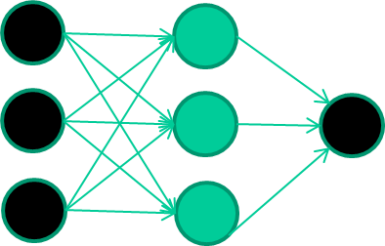
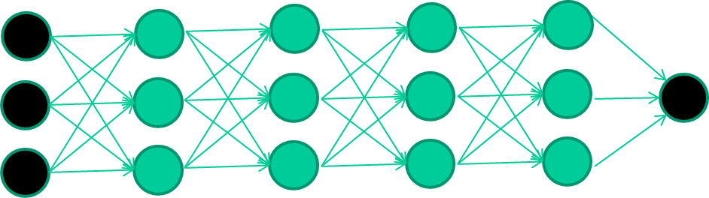
hmmm… OK, but:
3. multilayer neural networks have been around for
25 years. What’s actually new?
we have always had good algorithms for learning the
weights in networks with 1 hidden layer
but these algorithms are not good at learning the weights for
networks with more hidden layers
what’s new is: algorithms for training many-later networks

Slide 6
longer answers
reminder/quick-explanation of how neural network weights are learned;
the idea of unsupervised feature learning (why ‘intermediate features’ are important for difficult classification tasks, and how NNs seem to naturally learn them)
The ‘breakthrough’ – the simple trick for training Deep neural networks

Slide 7
The decision boundary perspective…
Initial random weights

Slide 8
The decision boundary perspective…
Present a training instance / adjust the weights

Slide 9
The decision boundary perspective…
Present a training instance / adjust the weights

Slide 10
The decision boundary perspective…
Present a training instance / adjust the weights

Slide 11
The decision boundary perspective…
Present a training instance / adjust the weights

Slide 12
The decision boundary perspective…
Eventually ….

Slide 13
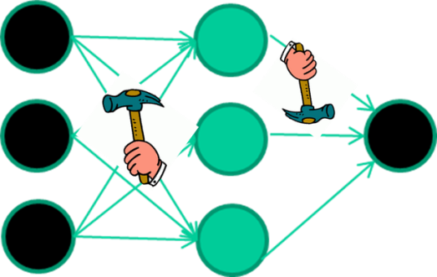
The point I am trying to make
weight-learning algorithms for NNs are dumb
they work by making thousands and thousands of tiny adjustments, each making the network do better at the most recent pattern, but perhaps a little worse on many others
but, by dumb luck, eventually this tends to be good enough to
learn effective classifiers for many real applications

Slide 14
Some other points
Detail of a standard NN weight learning algorithm – later
If f(x) is non-linear, a network with 1 hidden layer can, in theory, learn perfectly any classification problem. A set of weights exists that can produce the targets from the inputs. The problem is finding them.

Slide 15
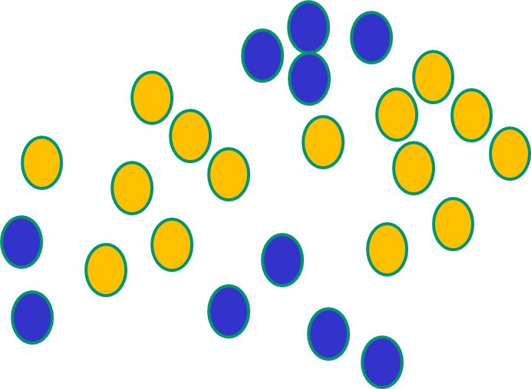
Some other ‘by the way’ points
If f(x) is linear, the NN can only draw straight decision boundaries (even if there are many layers of units)

Slide 16
Some other ‘by the way’ points
NNs use nonlinear f(x) so they
can draw complex boundaries,
but keep the data unchanged

Slide 17
Some other ‘by the way’ points
NNs use nonlinear f(x) so they SVMs only draw straight lines,
can draw complex boundaries, but they transform the data first
but keep the data unchanged in a way that makes that OK

Slide 18
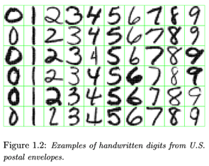
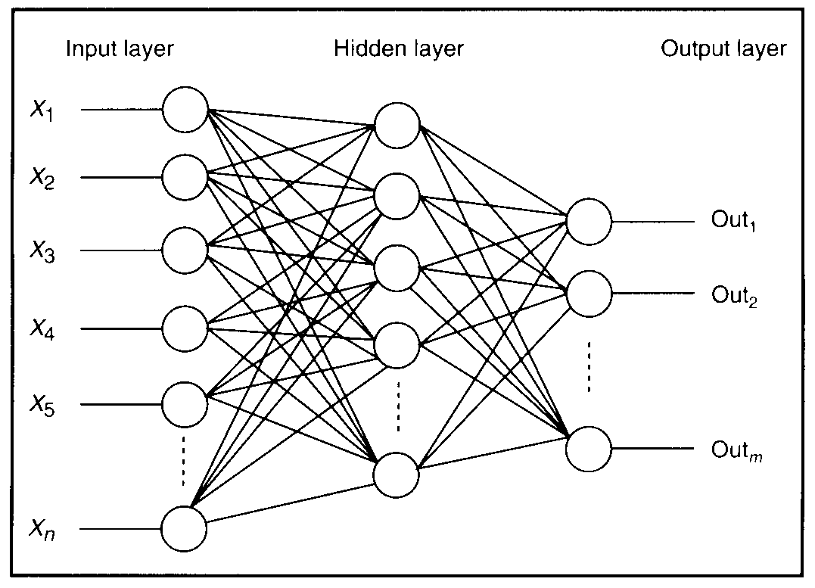

Feature detectors

Slide 19
what is this unit doing?

Slide 20
Hidden layer units become self-organised feature detectors
1 5 10 15 20 25 …
…
1
strong +ve weight
low/zero weight
63

Slide 21
What does this unit detect?
1 5 10 15 20 25 …
…
1
strong +ve weight
low/zero weight
63

Slide 22
What does this unit detect?
1 5 10 15 20 25 …
…
1
strong +ve weight
low/zero weight
it will send strong signal for a horizontal
line in the top row, ignoring everywhere else
63

Slide 23
What does this unit detect?
1 5 10 15 20 25 …
…
1
strong +ve weight
low/zero weight
63

Slide 24
What does this unit detect?
1 5 10 15 20 25 …
…
1
strong +ve weight
low/zero weight
Strong signal for a dark area in the top left
corner
63

Slide 25
What features might you expect a good NN
to learn, when trained with data like this?

Slide 26
vertical lines
1
63

Slide 27
Horizontal lines
1
63

Slide 28
Small circles
1
63

Slide 29
Small circles
1
But what about position invariance ???
our example unit detectors were tied to
specific parts of the image
63

Slide 30
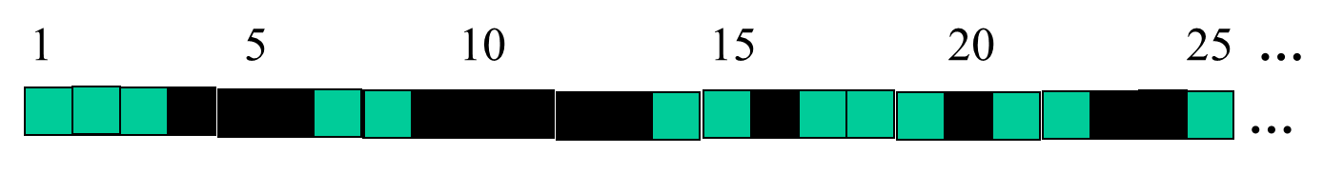
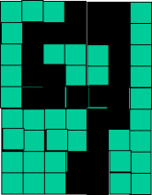
successive layers can learn higher-level features …
detect lines in
Specific positions
etc …
Higher level detetors
( horizontal line,
“RHS vertical lune”
“upper loop”, etc…
etc …
v

Slide 31
successive layers can learn higher-level features …
detect lines in
Specific positions
etc …
Higher level detetors
( horizontal line,
“RHS vertical lune”
“upper loop”, etc…
etc …
v
What does this unit detect?

Slide 32
So: multiple layers make sense

Slide 33
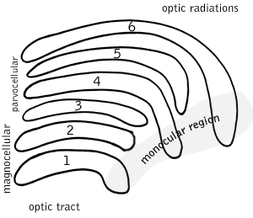
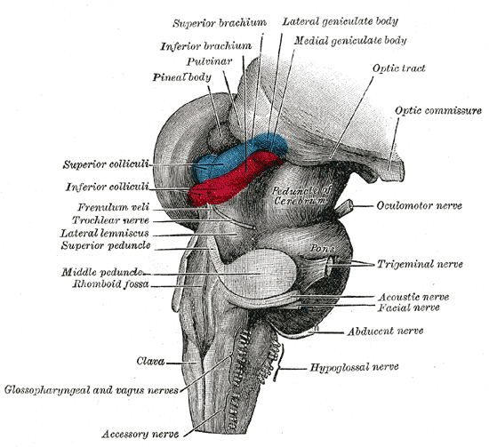
So: multiple layers make sense
Your brain works that way

Slide 34
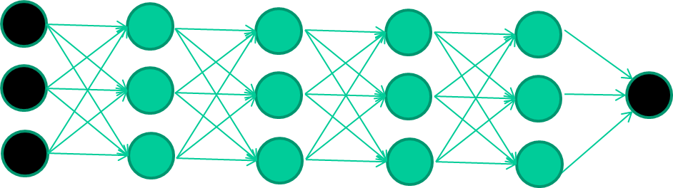
So: multiple layers make sense
Many-layer neural network architectures should be capable of learning the true underlying features and ‘feature logic’, and therefore generalise very well …

Slide 35


But, until very recently, our weight-learning algorithms simply did not work on multi-layer architectures

Slide 36
Along came deep learning …

Slide 37
The new way to train multi-layer NNs…

Slide 38
The new way to train multi-layer NNs…
Train this layer first

Slide 39
The new way to train multi-layer NNs…
Train this layer first
then this layer

Slide 40
The new way to train multi-layer NNs…
Train this layer first
then this layer
then this layer

Slide 41
The new way to train multi-layer NNs…
Train this layer first
then this layer
then this layer
then this layer

Slide 42
The new way to train multi-layer NNs…
Train this layer first
then this layer
then this layer
then this layer
finally this layer

Slide 43
The new way to train multi-layer NNs…
EACH of the (non-output) layers is trained to be an auto-encoder
Basically, it is forced to learn good features that describe what comes from the previous layer

Slide 44
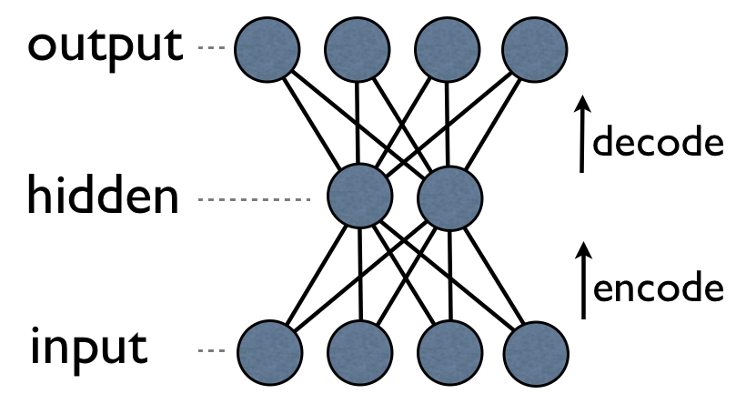
an auto-encoder is trained, with an absolutely standard weight-adjustment algorithm to reproduce the input

Slide 45
an auto-encoder is trained, with an absolutely standard weight-adjustment algorithm to reproduce the input
By making this happen with (many) fewer units than the inputs, this forces the ‘hidden layer’ units to become good feature detectors

Slide 46
intermediate layers are each trained to be auto encoders (or similar)

Slide 47
Final layer trained to predict class based on outputs from previous layers

Slide 48
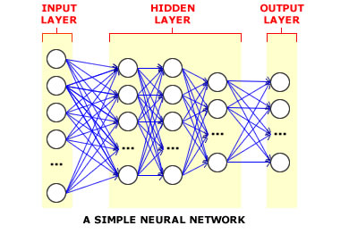
And that’s that
That’s the basic idea
There are many many types of deep learning,
different kinds of autoencoder, variations on architectures and training algorithms, etc…
Very fast growing area …

Slide 49
Deep Net Feature Transformation
Supervised
Learning
ML Model
New Feature Space
Supervised
or
unsupervised
Learning
Original Features
Notes:
Can input both new and original spaces
Unsupervised pre-training

Slide 50
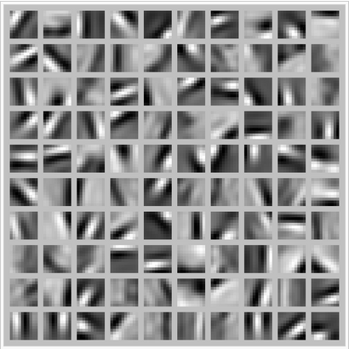
Deep Learning Tasks
For some approaches (CNN, Unsupervised) best when input space is locally structured – spatial or temporal: images, language, etc. vs arbitrary input features
Images Example: view of a learned vision feature layer (Basis)
Each square in the figure shows the input image that maximally activates one of the 100 units
Notes:
Each square in the figure above shows the (norm bounded) input image that maximally activates one of 100 hidden units. We see that the different hidden units have learned to detect edges at different positions and orientations in the image.
This image if for a simple auto-encoder with 100 hidden units trained on 10x10 images (from UFLDL tutorial)

